Slide 2

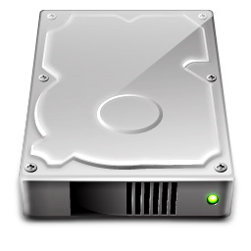
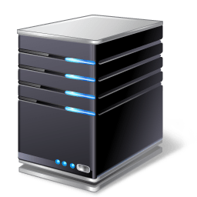


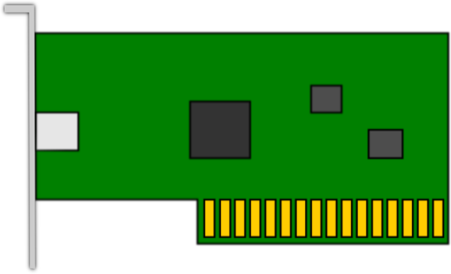
Fault Tolerance and Redundancy
Notes:
Fault tolerance is the property that enables a system to continue operating properly in the event of the failure of some of its components

Slide 3

Fault Tolerance and Redundancy
ISP 1
ISP 2
Link 2
Link 1
Notes:
Fault tolerance is the property that enables a system to continue operating properly in the event of the failure of some of its components

Slide 4
High Availability
How closely does a system achieve 100% uptime
Availability | Downtime (per year) | Downtime (per month) | Downtime (per week) | Downtime (per day)
99.0% (two 9s) | 3.65 days | 7.31 hours | 1.68 hours | 14.4 minutes
99.9% (three 9s) | 8.77 hours | 43.83 minutes | 10.08 minutes | 1.44 minutes
99.99% (four 9s) | 52.6 minutes | 4.38 minutes | 1.01 minutes | 8.64 seconds
99.999% (five 9s) | 5.25 minutes | 26.3 seconds | 6.05 seconds | 864 ms

Slide 5
RAID 0 - Striping
Disk 1
Disk 2
Performance increase
No fault tolerance
No storage overhead
Applications
Virtual Machines
W1
W2
W3
W4
W5
W6
W7
W8

Slide 6

RAID 1 - Mirroring
Disk 2
No Performance increase
Fault tolerance
50% storage overhead
Disk 1
Applications
Virtual Machines
W1
W1
W2
W2
W3
W3
W4
W4

Slide 7
RAID 5 – Striping w/Parity
Disk 3
Performance increase
Fault tolerance*
50% storage overhead
Disk 1
Disk 2
W1
W2
Parity Bit
W3
Parity Bit
W4
Parity Bit
W5
W6
W7
W8
Parity Bit
Notes:
If two disks in the array fail, the array is lost

Slide 8
RAID 10 – RAID 0+1
Strip 1
(RAID 0)
Stripe 2
(RAID 0)
Disk 1
Disk 2
Disk 3
Disk 4
W1
W2
(RAID 1)
W1
W2
Mirrored
W3
W4
W3
W4
W5
W6
W5
W6
W7
W8
W7
W8
Notes:
3- 32 disks

Slide 9
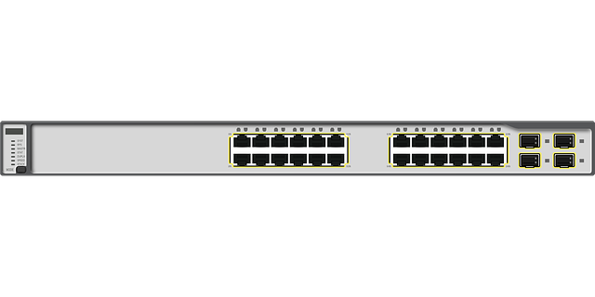
Storage Area Networks
HBA 1
HBA 2
HBA 3
HBA 4
FC SW 1
FC SW 2
SP 1
Storage Array
SP 2
Notes:
File System Permissions
NTFS Permission
Share Permissions

Slide 10
NIC Teaming
Switch
Server
NIC 1
10G
NIC 2
10G

Slide 11
Clusters and Load Balancers
Server Cluster 1
Server Cluster 2
Load Balancer
Internet
Web Requests
Web Requests
Notes:
File System Permissions
NTFS Permission
Share Permissions

Slide 12
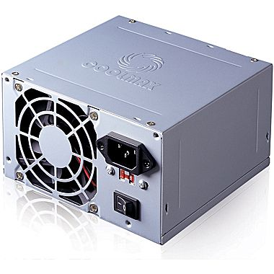
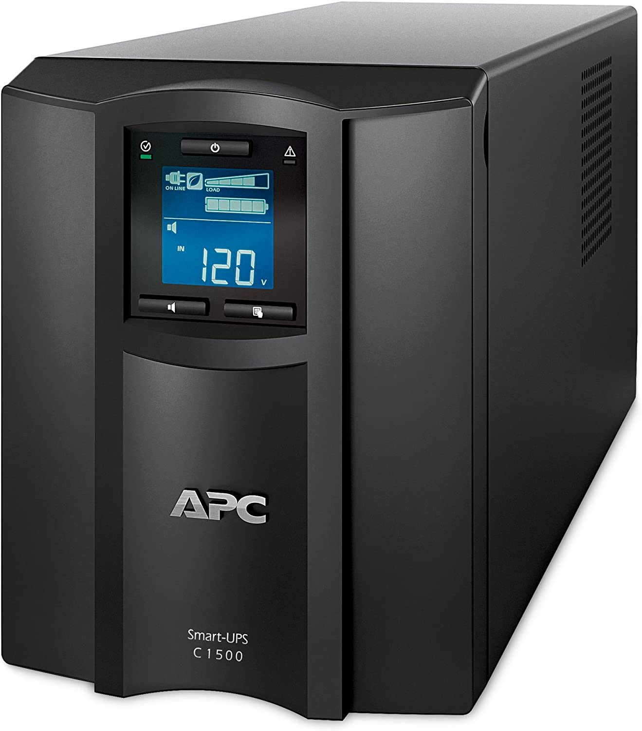
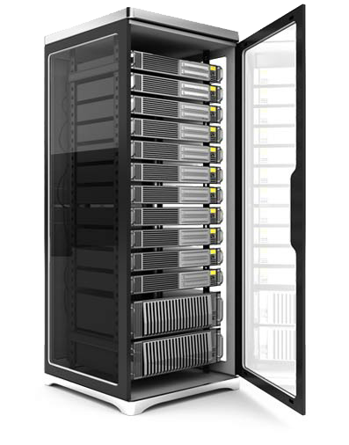
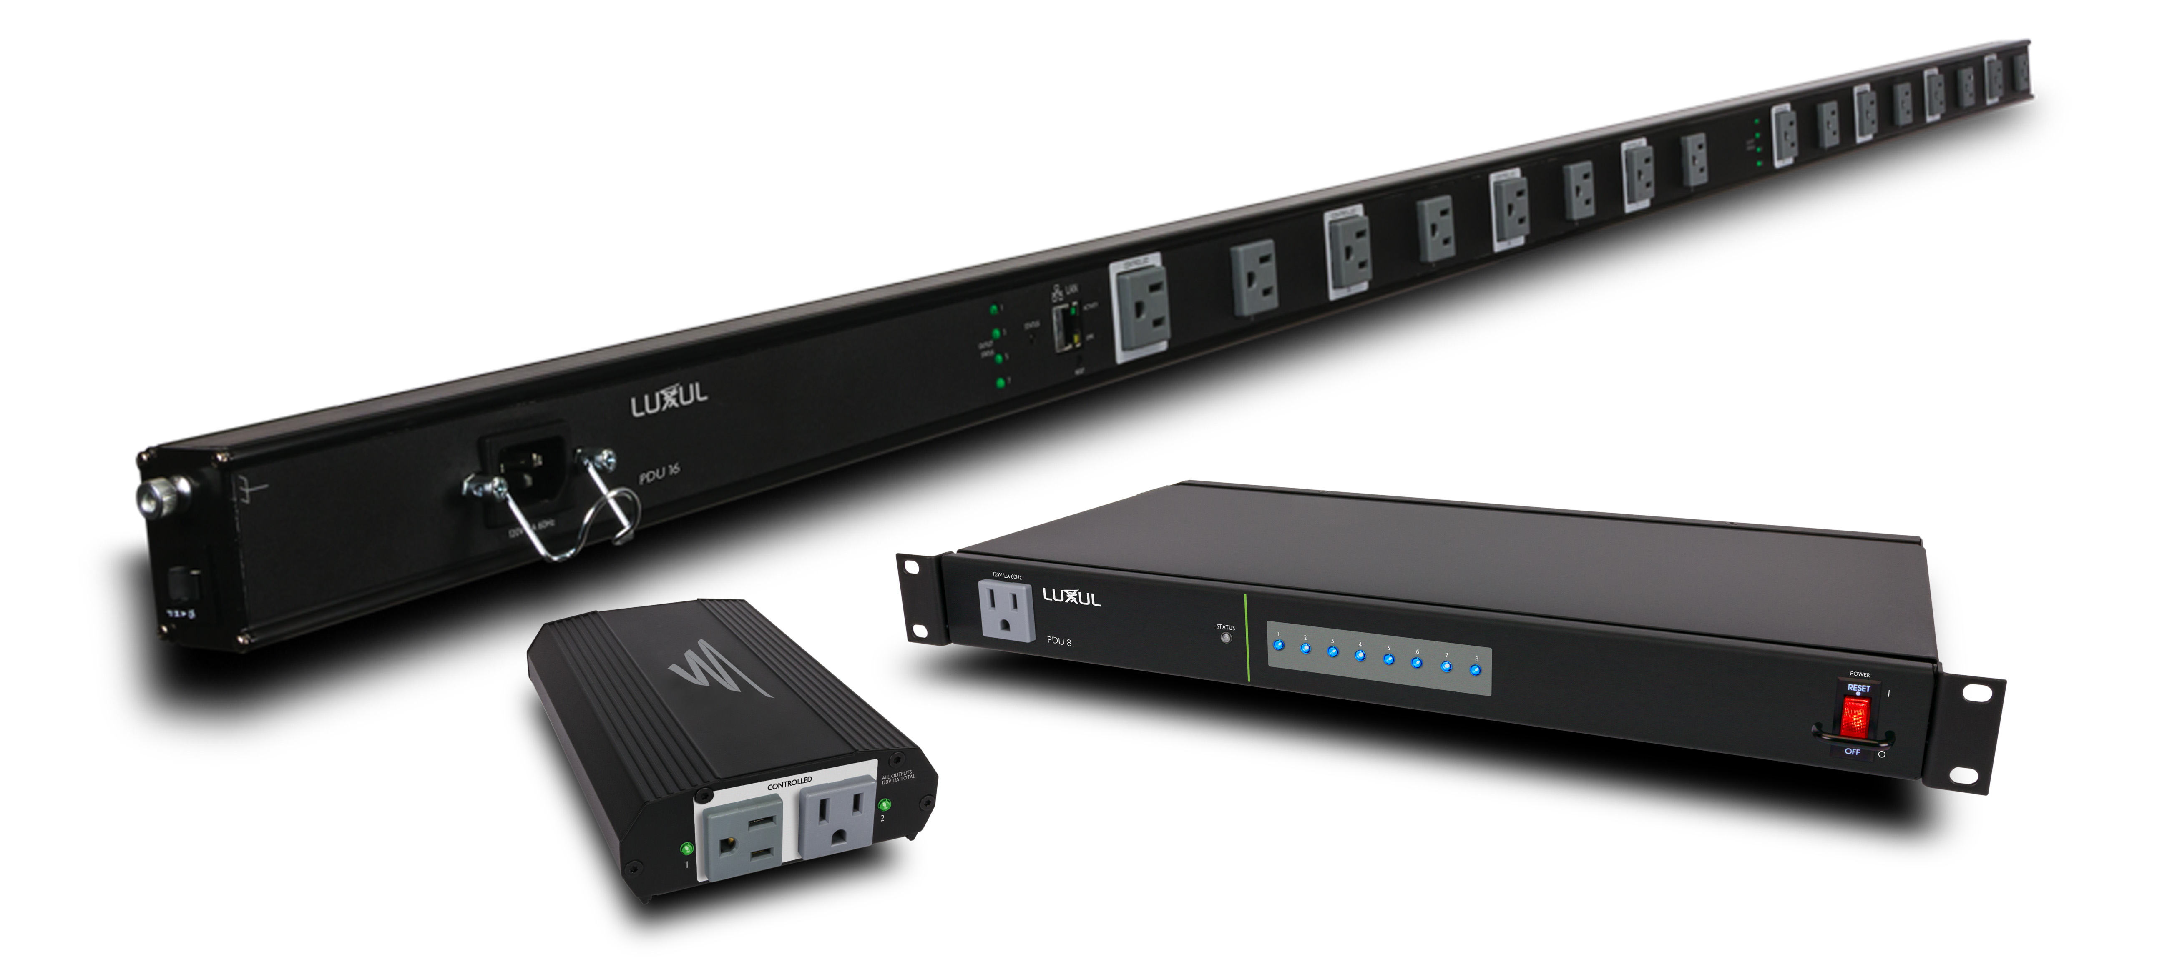
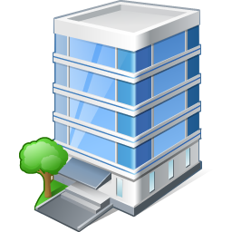
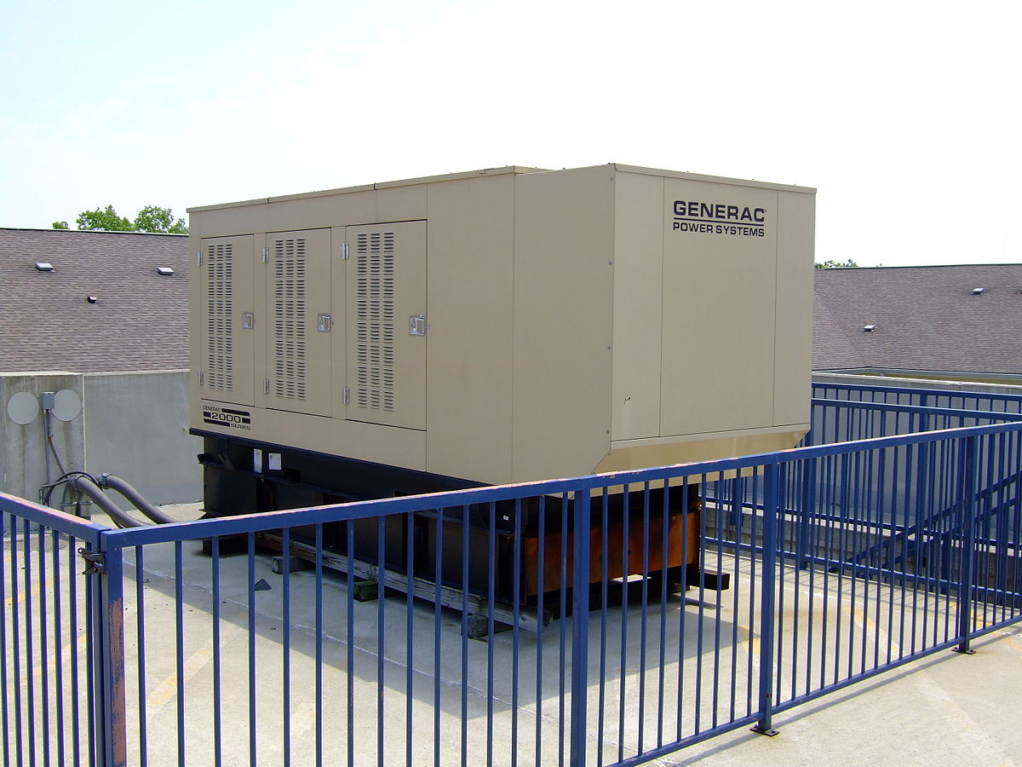
Power Redundancy
Dual PSUs
UPS
Managed PDU
Generators

